Slide 1
Dashboard Changes
05, May 2023 – Pulkit Jain

Slide 2
Notes:-
A new coupon was created today and made live “test360” to give users 360days activating for testing our app
This coupon was assigned to our Brand Ambassador “Arjun” as donor
Challenges noticed are mentioned in the slide.
Take support of our tech team wherever their roles are required.

Slide 3
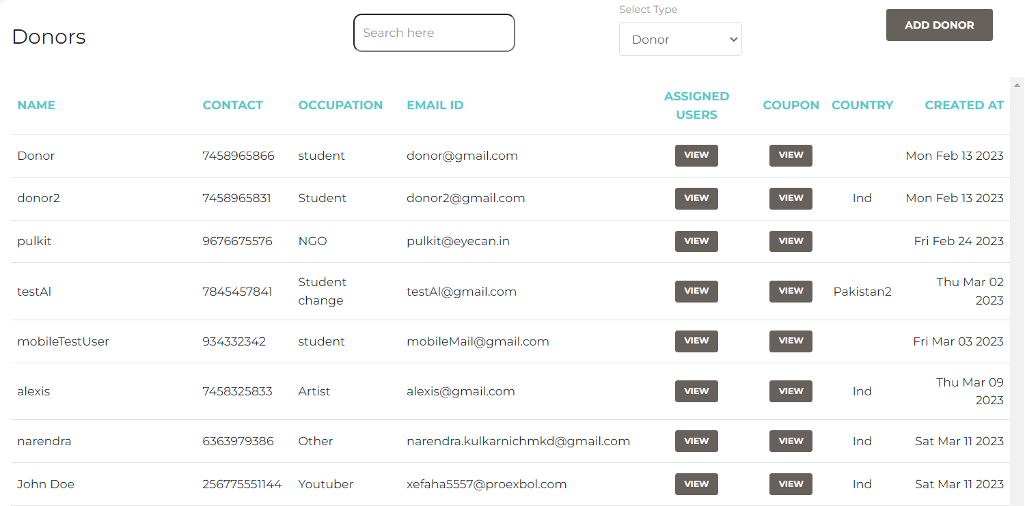
Option to delete a donor and user

Slide 4
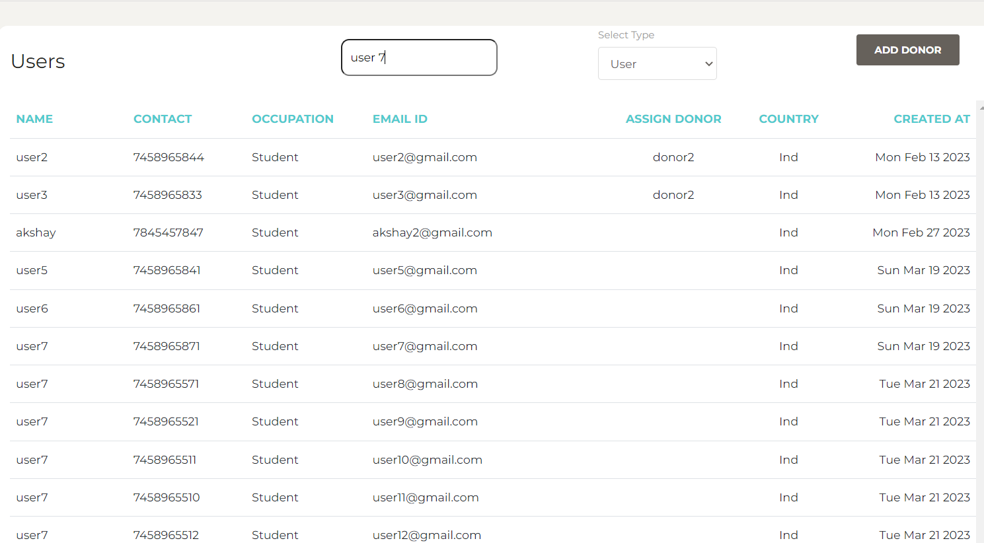
Search bar is not working

Slide 5
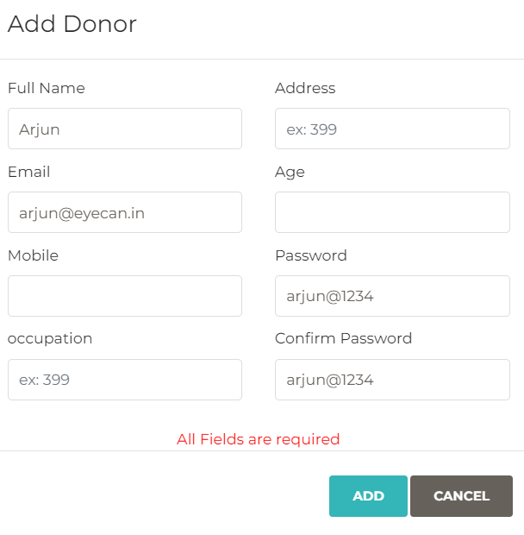
Replace “Age” with “Organization name”

Slide 6
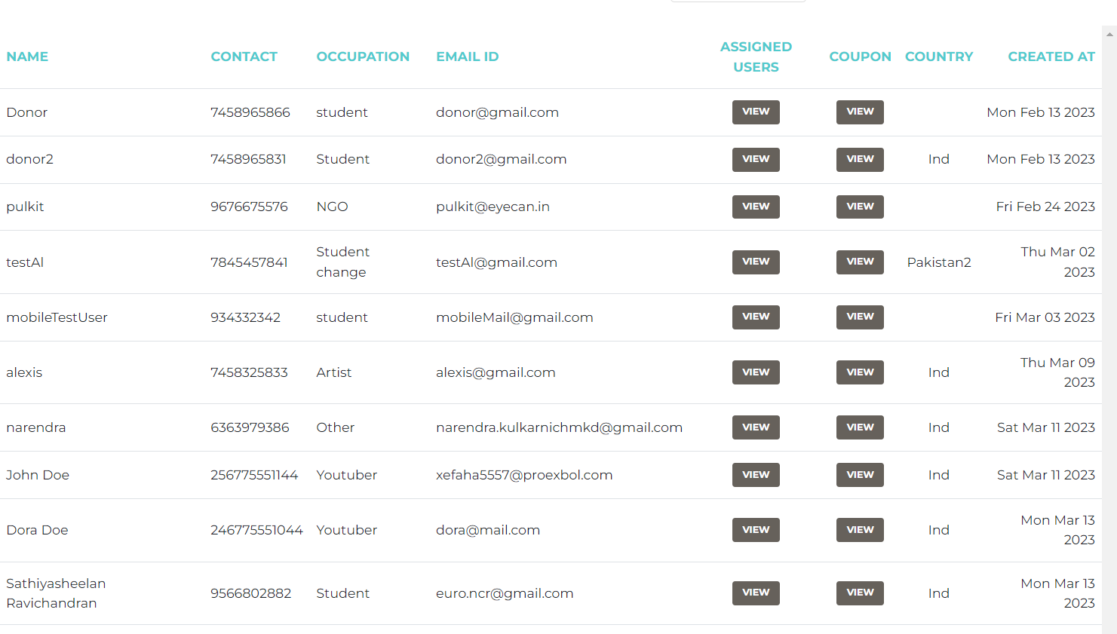
In both user and donor section they are listed from old to new (It should be reversed)
It would be better
To have a sorting
Filter and option to
Select date rages
From an calendrer

Slide 7
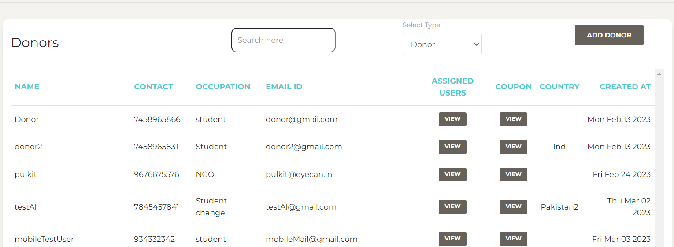
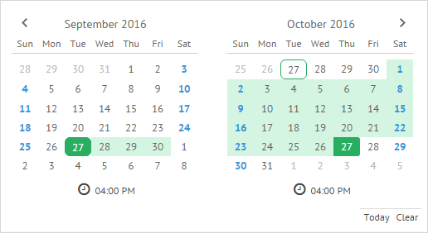
Maybe a calendar here to view both user and donor data based on date range selected

Slide 8
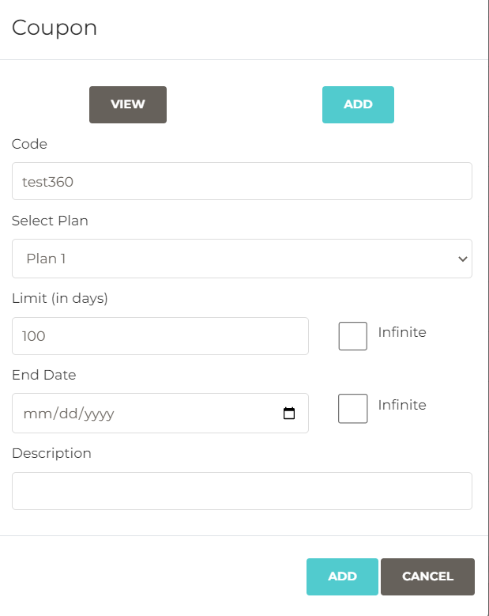
“Limit (in days)” just text to be replaced by Limit (No.Users)

Slide 9
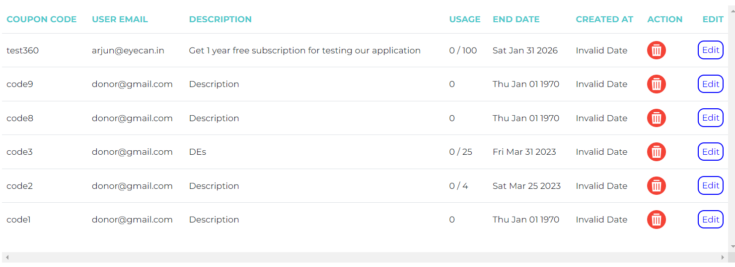
“Created at” date is not showing date of creation and End date is coming in past for coupon that are set to infinite
v
v

Slide 10
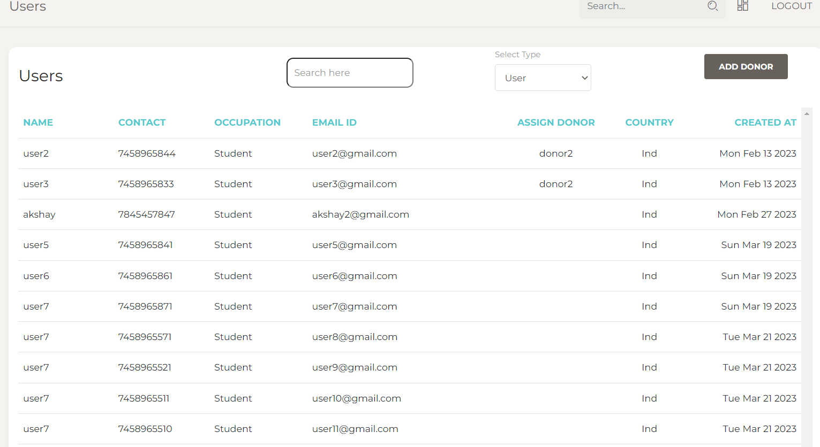
Only users with Coupon code are coming on dashboard, we want users without coupon code to also come on dashboard

Slide 11
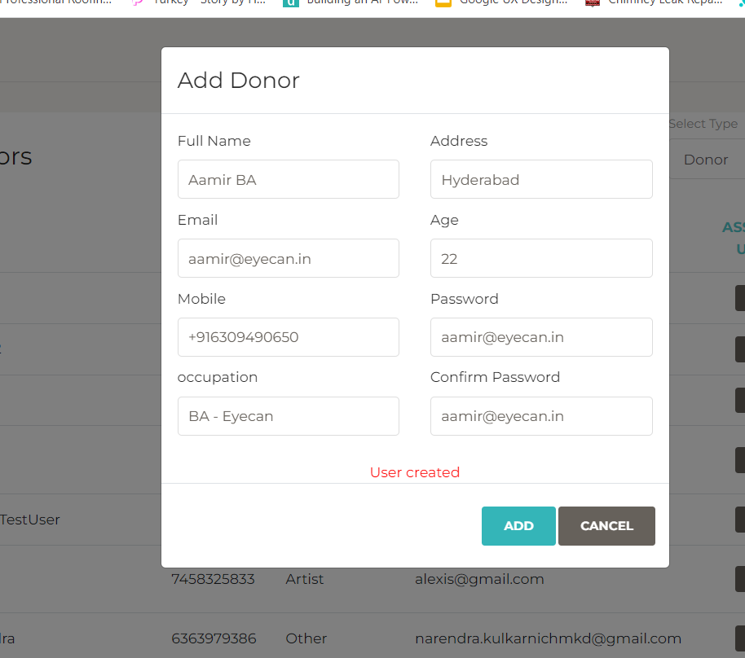
When creating new user “After creating of user this window should close automatically”

Slide 12
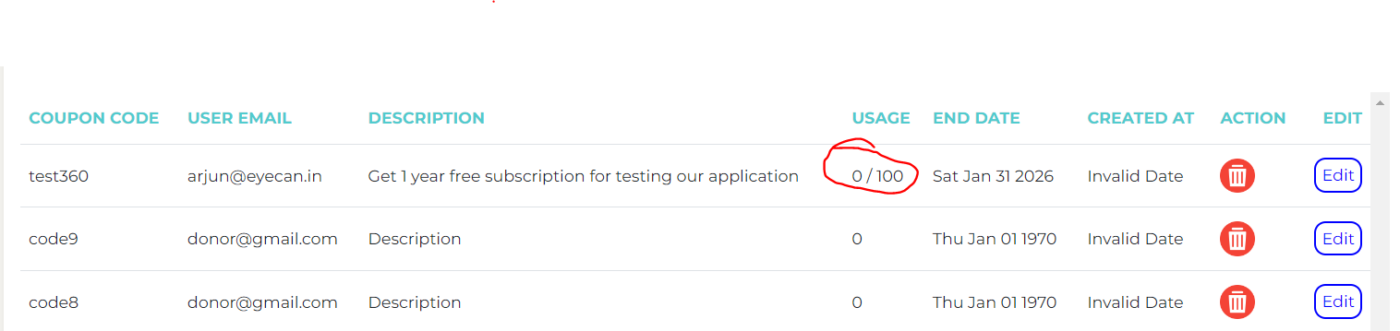
Even when Invite code being used, these numbers are not updating

Slide 13
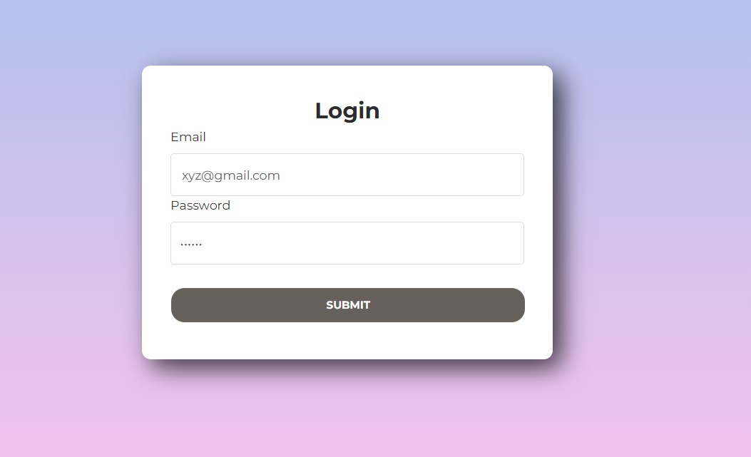
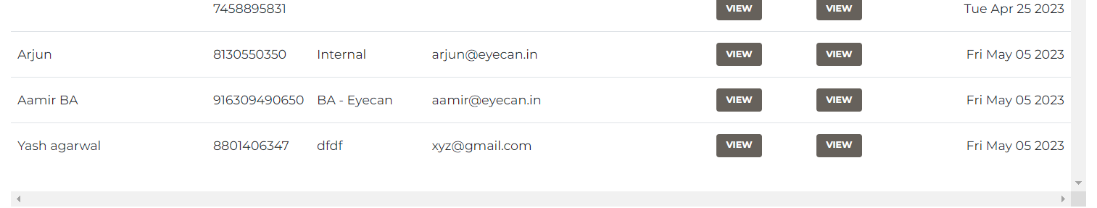
While login as donor “ Donors which we are creating are not being able to login” – Only donor@gmail.com is working

Slide 14
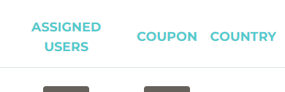
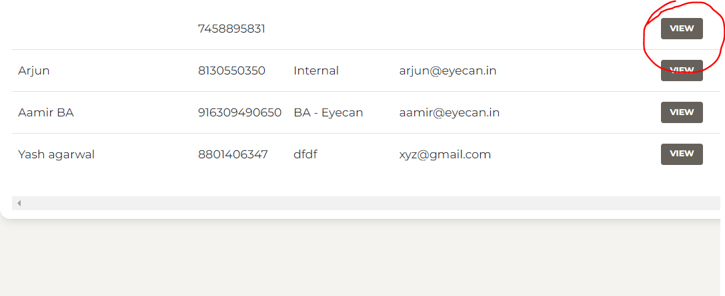
When clicking on View on assigned users it is not showing the data of users who used the Coupon code

Slide 15
In backed Remove Address field and replace Postal code with "City“ – User form
Coordinate with Alzhar or Varish for more details

